Slide 1
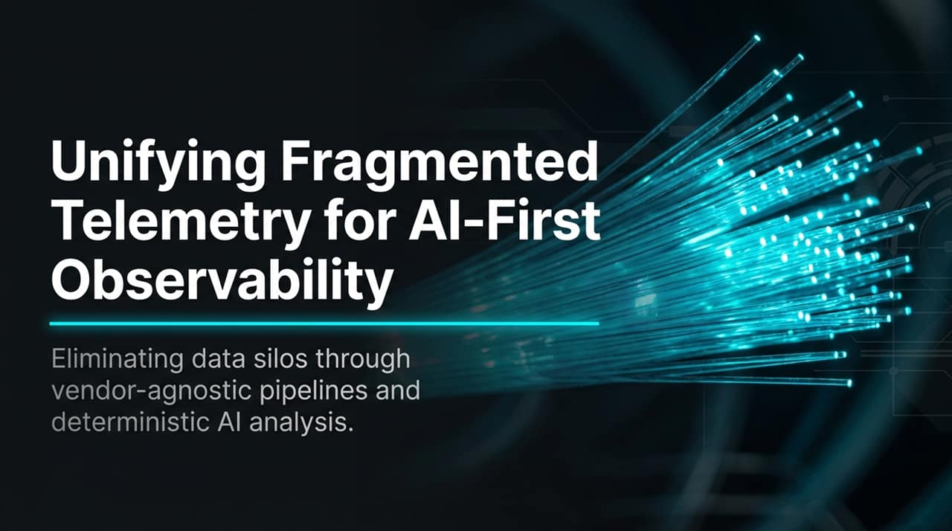
Notes:
Good evening, everyone. Today, we are discussing one of the most persistent hurdles in modern enterprise IT: managing telemetry logs effectively across fragmented environments.
Logs continue to live in disjointed silos—security teams use dedicated SIEMs, operations teams use APM platforms, and compliance teams rely on distinct audit stores.
As organizations transition toward AI-first operating models, this fragmentation creates massive friction. You cannot run effective AI models over isolated data pools.
In this presentation, we will examine how unifying log collection through vendor-agnostic pipelines—specifically leveraging Bindplane alongside Dynatrace—allows us to eliminate data silos, centralize pipeline routing, and execute deterministic AI correlation across complex application landscapes.
Dynatrace x Bindplane - One Source Many Destinations with AI Analysis
https://www.youtube.com/watch?v=QSUPYC_ydas

Slide 2
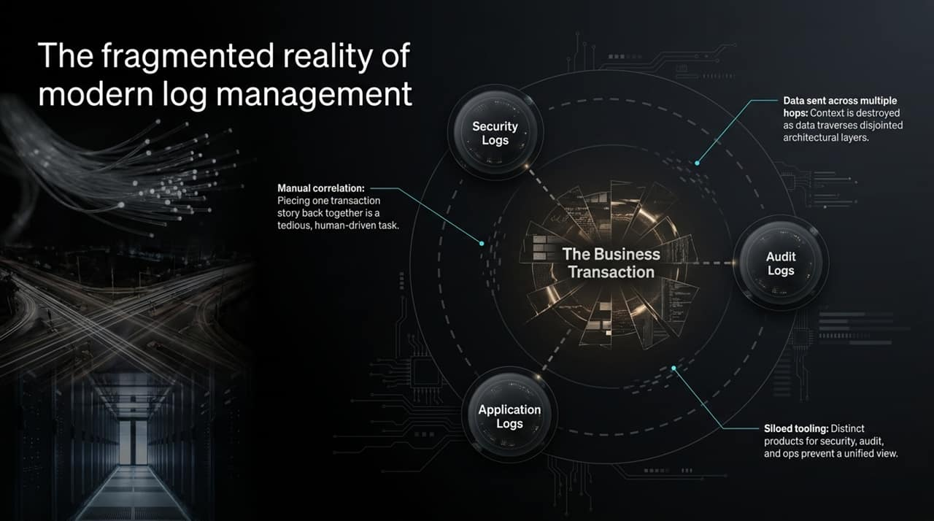
Notes:
Let's take a closer look at the actual state of modern log management in enterprise ecosystems.
A single business transaction rarely lives inside a single microservice or server. It traverses multiple architectural layers: front-end client web applications, back-end APIs, authentication services, database layers, and third-party gateways.
Because teams deploy siloed tooling—Security Logs into a SIEM, Application Logs into APM, and Audit Logs into separate storage—context is systematically destroyed as data crosses these disjointed boundaries.
When an incident occurs or a transaction fails, engineers are forced into manual correlation. They manually query different systems using disparate query languages, attempting to piece together the lifecycle of a single request across multiple tool interfaces.
This manual process inflates Mean Time to Resolution (MTTR) from minutes to hours.

Slide 3
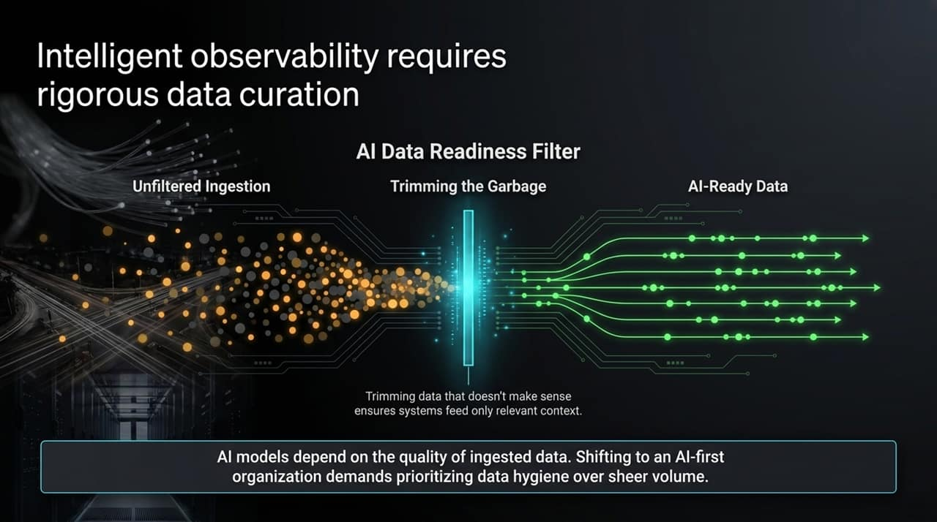
Notes:
A critical concept in moving to an AI-first architecture is understanding that more data does not equal better AI.
In fact, feeding raw, uncurated, high-volume telemetry directly into AI engines leads to noise, delayed analysis, and unnecessary ingestion costs.
As noted in our discussions on AI efficiency: 'Garbage in is garbage out.' AI systems depend heavily on high-fidelity context.
This slide illustrates the AI Data Readiness Filter pipeline:
Unfiltered Ingestion: Capturing raw log events at the edge.
Trimming the Garbage: Filtering out debug noise, routine health checks, and redundant events at the gateway layer before reaching storage.
AI-Ready Data: Streaming structured, clean, context-rich telemetry into the AI analytical layer.
By prioritizing data hygiene over pure volume, we ensure that AI tools like Dynatrace Assist process highly relevant context, yielding precise dependencies without performance bottlenecks.

Slide 4
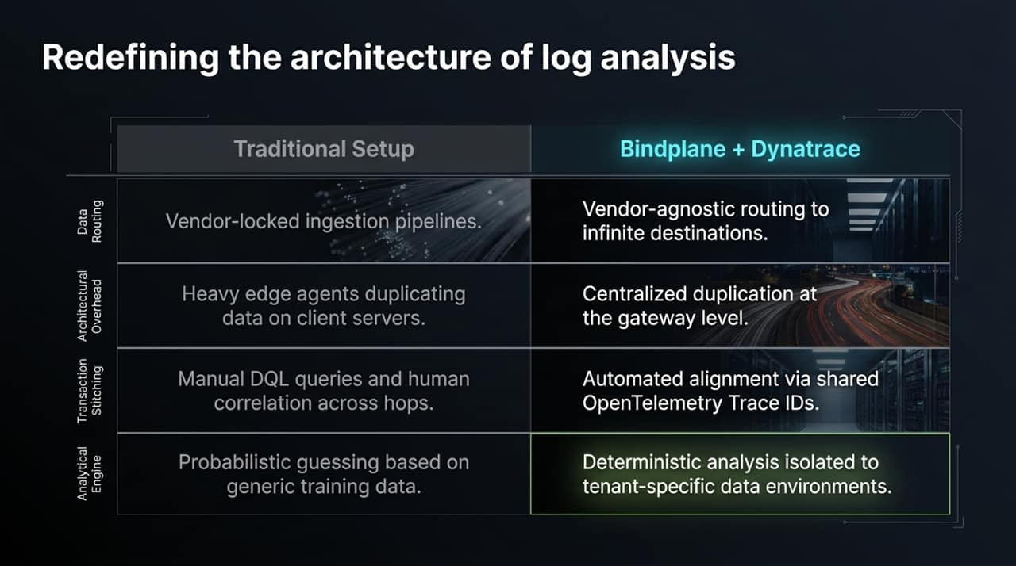
Notes:
To fix log fragmentation, we must redefine the architectural foundation. Let's compare traditional log setups against our modernized Bindplane + Dynatrace framework across four core dimensions:
1. Data Routing: Traditional pipelines lock you into vendor-proprietary agents and paths. With Bindplane, ingestion becomes vendor-agnostic, capable of routing telemetry to infinite destinations simultaneously.
2. Architectural Overhead: Legacy setups often run multiple heavy edge agents duplicating raw data directly on client host servers. We move duplication off application nodes and handle it centrally at the gateway level.
3. Transaction Stitching: Instead of writing complex manual queries (like DQL) across siloed systems, we enforce automated alignment via standardized OpenTelemetry Trace IDs.
4. Analytical Engine: Traditional AI features rely on probabilistic models trained on generic public datasets, which risks hallucinations. Dynatrace Assist operates deterministically within tenant-specific boundaries, evaluating actual system dependencies.

Slide 5
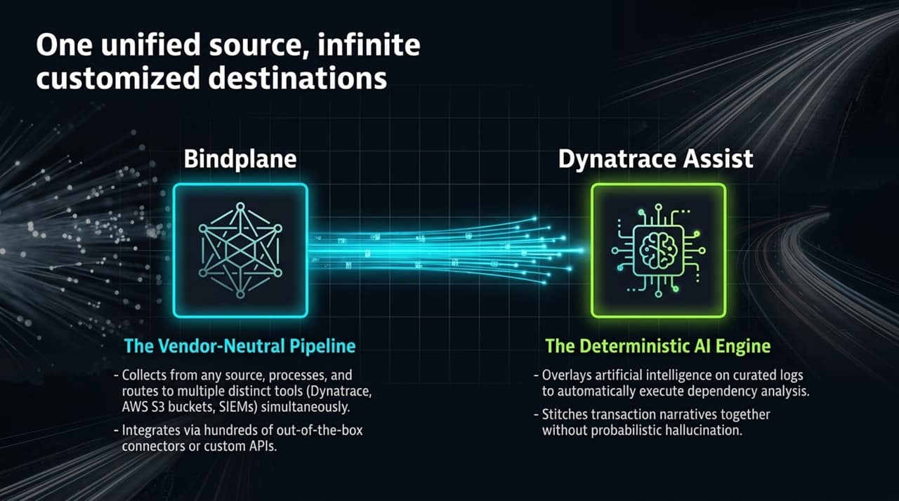
Notes:
Here we examine the dual-component model of this architecture: The Vendor-Neutral Pipeline (Bindplane) and The Deterministic AI Engine (Dynatrace Assist).
Bindplane acts as the ingestion workhorse. It collects telemetry from any log source or system agent using hundreds of out-of-the-box connectors or custom APIs. It then processes and streams those logs into multiple targets concurrently—for example, sending operational metrics to Dynatrace, cold compliance logs to an AWS S3 bucket, and security events to a SIEM.
Dynatrace Assist overlays this unified, curated telemetry. Because the incoming telemetry is structured and clean, the AI automatically maps dependency relationships across services and stitches full transaction narratives without making probabilistic guesses.

Slide 6
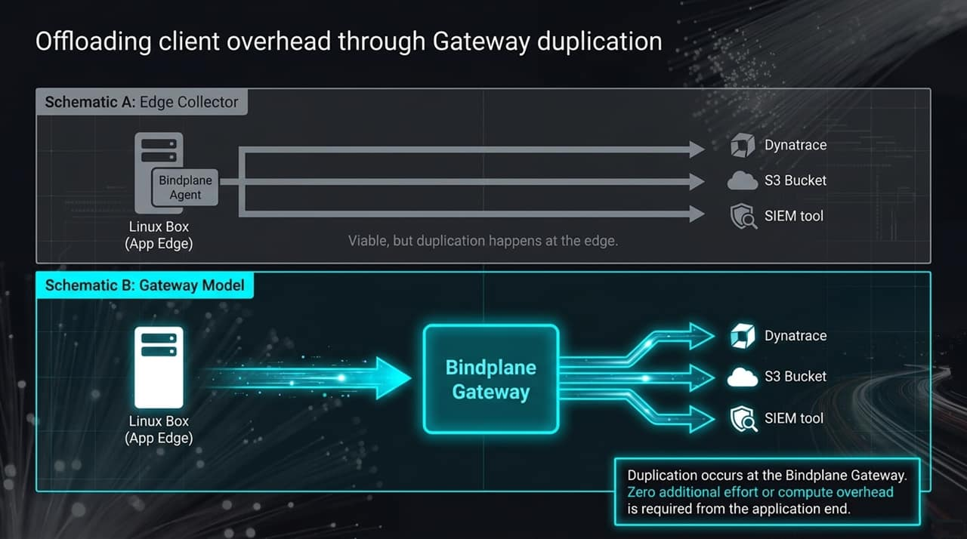
Notes:
Architecturally, how do we handle duplicating log data to multiple systems without overwhelming host servers?
Look at Schematic A (Edge Collector Model). If an agent on an application server (e.g., a Linux host) is tasked with formatting and sending identical data streams to Dynatrace, S3, and a SIEM simultaneously, network bandwidth and CPU/memory consumption double or triple on that production box.
Now review Schematic B (Gateway Model). The edge collector running on the application server sends a single, lightweight stream to a Bindplane Gateway.
The Gateway handles all parsing, transformation, filtering, and fan-out duplication to Dynatrace, S3, and SIEM tools. This offloads compute overhead entirely from production application nodes, simplifying maintenance and improving edge performance.

Slide 7
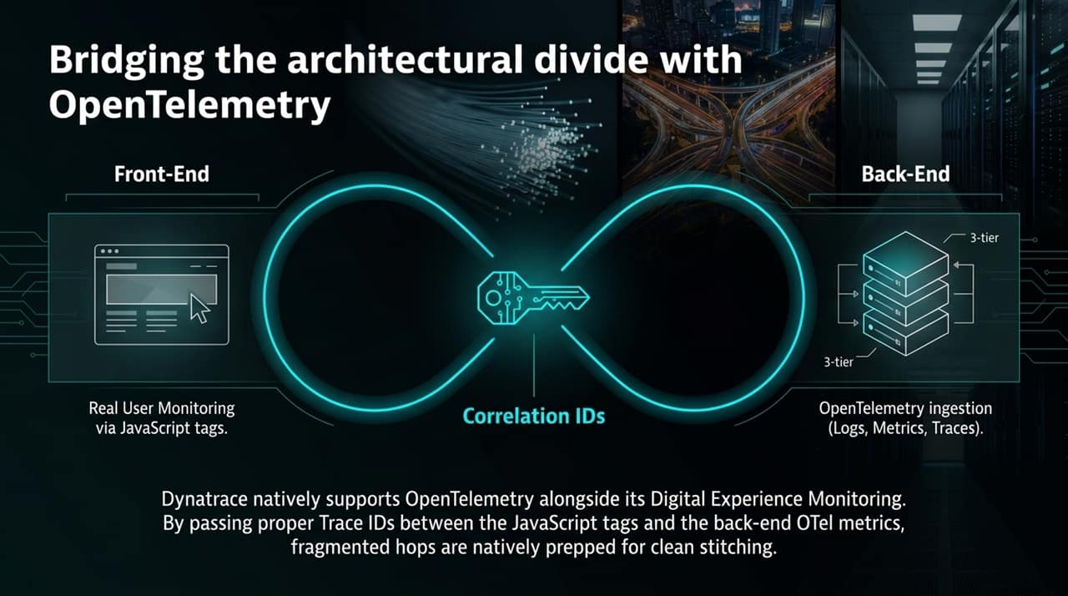
Notes:
A common architectural challenge is correlating front-end user actions with multi-tier back-end trace events.
Consider a scenario where the front end uses Real User Monitoring (RUM) via Dynatrace JavaScript tags, while the microservice back end uses vendor-agnostic OpenTelemetry (OTel) collectors.
Dynatrace natively supports OpenTelemetry log, metric, and trace ingestion alongside digital experience monitoring tags.
By propagating standardized Correlation / Trace IDs from the JavaScript client request headers down through back-end OpenTelemetry layers, every hop preserves context.
This seamless bridge allows front-end user sessions to be directly linked with back-end execution traces and log streams automatically.

Slide 8
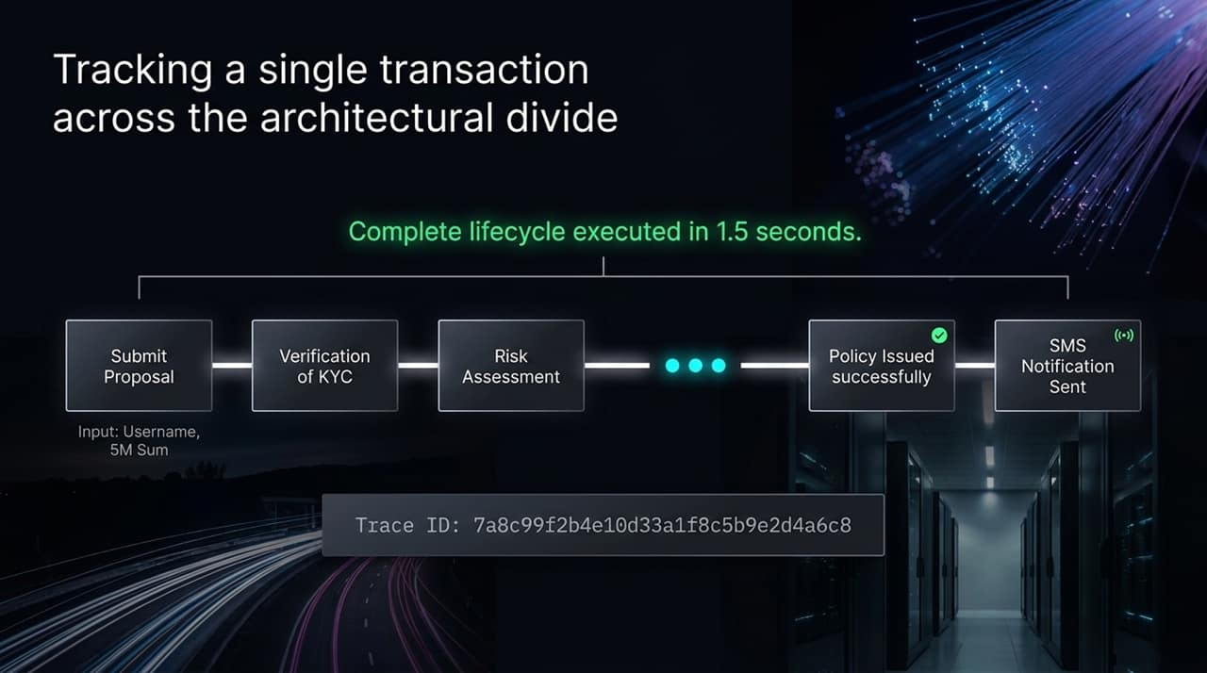
Notes:
Let's walk through an end-to-end multi-step transaction from the demo insurance application.
The business transaction spans seven distinct stages:
Proposal Submission
KYC Verification
Risk Assessment
Underwriting Approval
Policy Issuance
Payment Processing / System Confirmation
SMS Notification Delivery
The entire end-to-end flow executes in roughly 1.5 seconds. However, each step generates logs across distinct application services and databases.
By assigning a unique Trace ID (7a8c99f2b4e10d33a1f8c5b9e2d4a6c8) across every hop during execution, we maintain a clear common thread through all seven stages.

Slide 9
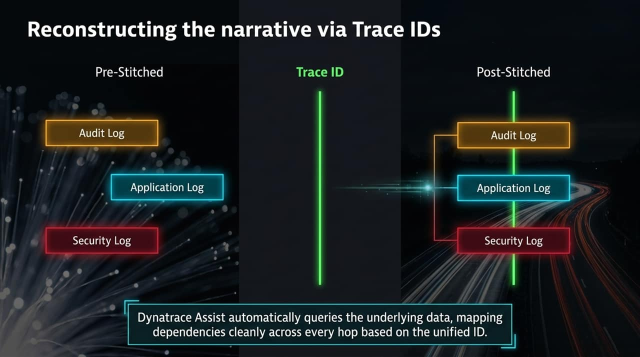
Notes:
On this slide, we contrast Pre-Stitched vs. Post-Stitched log views.
Pre-Stitched: Before correlation, Audit Logs, Application Logs, and Security Logs sit disjointed. They appear as separate, unrelated time-series events in different tools.
Trace ID Correlation: When Bindplane routes these logs into Dynatrace with consistent OpenTelemetry Trace IDs, Dynatrace Assist maps them along a single contextual spine.
Post-Stitched: The AI engine automatically queries underlying log tables, arranging Audit, Application, and Security logs into a clean, sequential dependency tree. Engineers can immediately see the complete life cycle of the request across all system boundaries.

Slide 10
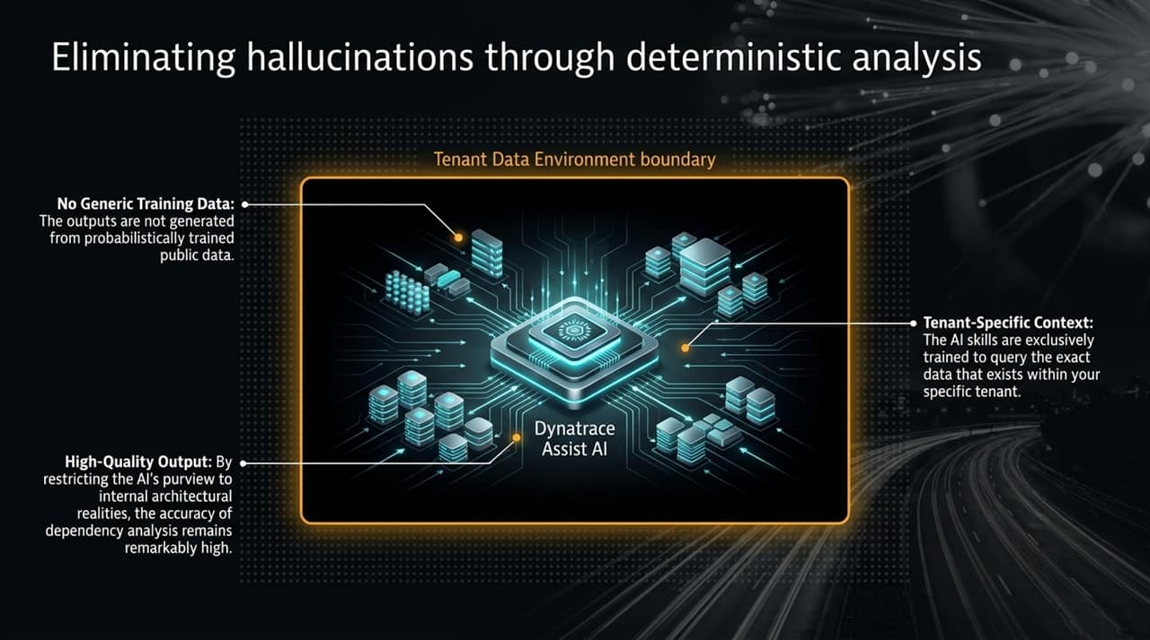
Notes:
A major concern with generative AI tools in enterprise operations is the risk of hallucinations or inaccurate inferences.
Dynatrace Assist addresses this by using deterministic analysis bounded within your specific tenant data environment.
Key architectural safeguards include:
No Generic Training Data Outputs: Answers are not generated from public LLMs trained on external web data.
Tenant-Specific Context: The AI skills are specifically built to query the actual telemetry data present inside your tenant's datastore.
High-Fidelity Dependency Graphing: Because the AI restricts its analysis to real system topologies and verified Trace IDs, dependency analysis remains accurate and reliable.

Slide 11
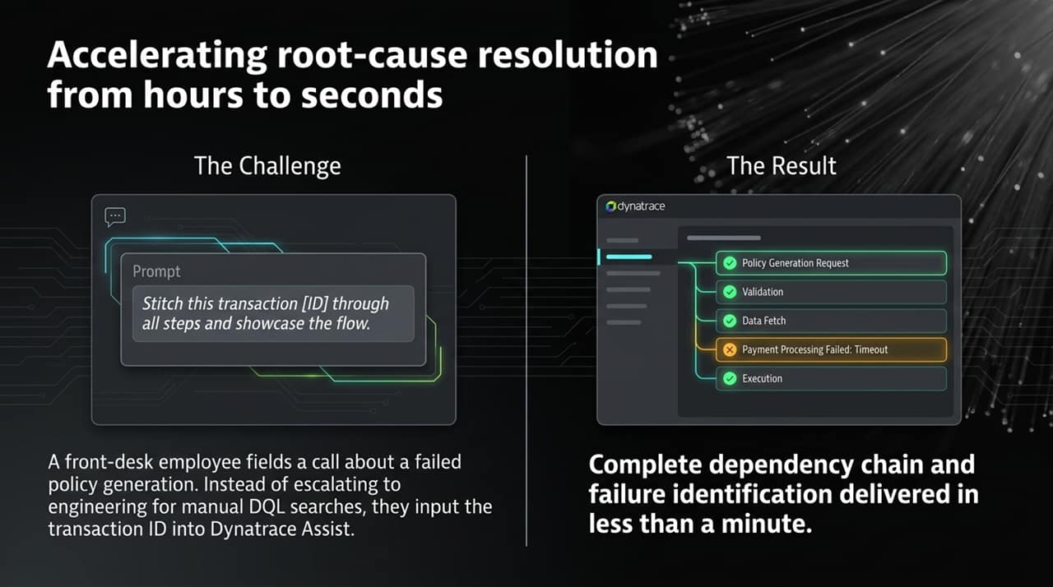
Notes:
How does this modern setup change day-to-day operations? Let's walk through a real operational incident.
The Scenario: A customer calls front-desk support stating that their policy generation failed. In a traditional environment, the support representative escalates the ticket to L2/L3 engineering teams, who spend hours running complex database and log queries.
The Modern Workflow: The support representative simply inputs the transaction ID into Dynatrace Assist with a plain text prompt: 'Stitch this transaction [ID] through all steps and showcase the flow.'
The Result: Within 30 seconds, Dynatrace Assist reconstructs all 7 steps, pinpoints the failure (e.g., Payment Processing Failed: Timeout), and displays the exact step where the process broke. Resolution time drops from hours to seconds.

Slide 12
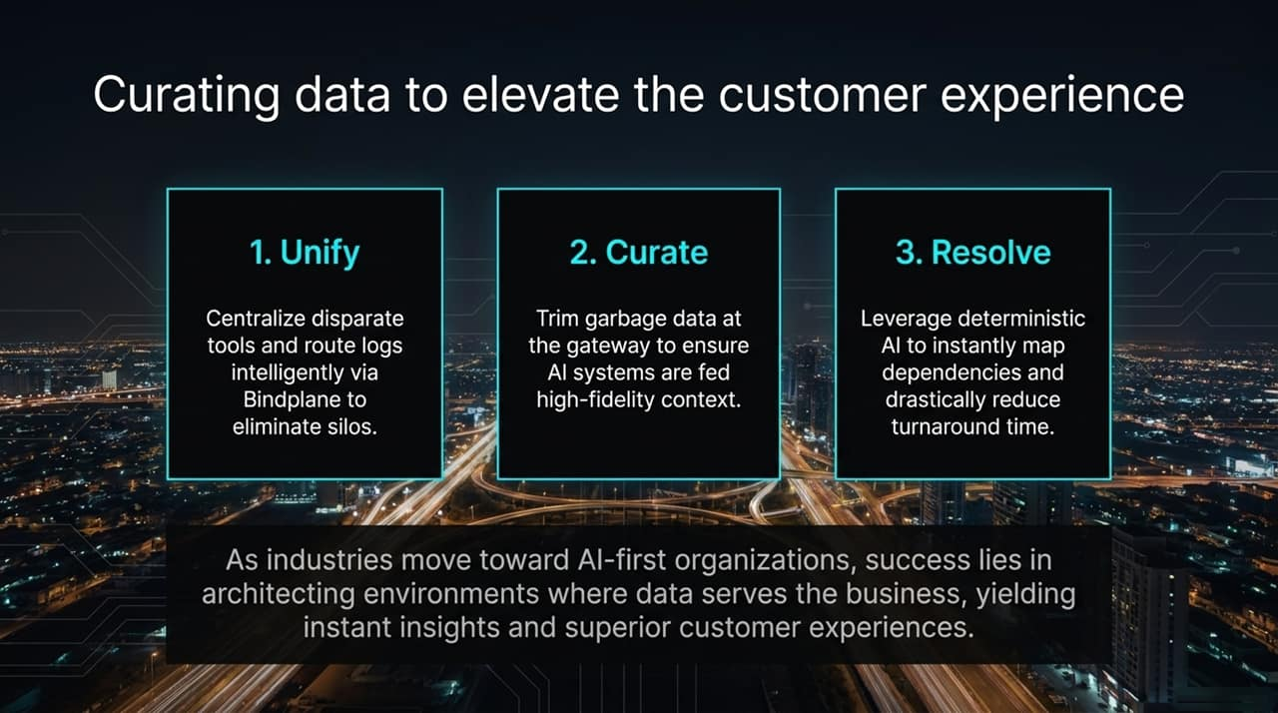
Notes:
To summarize our architectural journey, we condense the transition to AI-first observability into three core pillars:
Unify: Centralize disparate logs and route telemetry dynamically via Bindplane, breaking down tool silos.
Curate: Filter out low-value garbage data at the gateway layer to feed AI tools clean, high-fidelity context.
Resolve: Utilize deterministic AI (Dynatrace Assist) to stitch transaction flows instantly and eliminate long investigation cycles.
Ultimately, technical observability serves a core business objective: delivering fast, transparent, and reliable customer experiences.

Slide 13
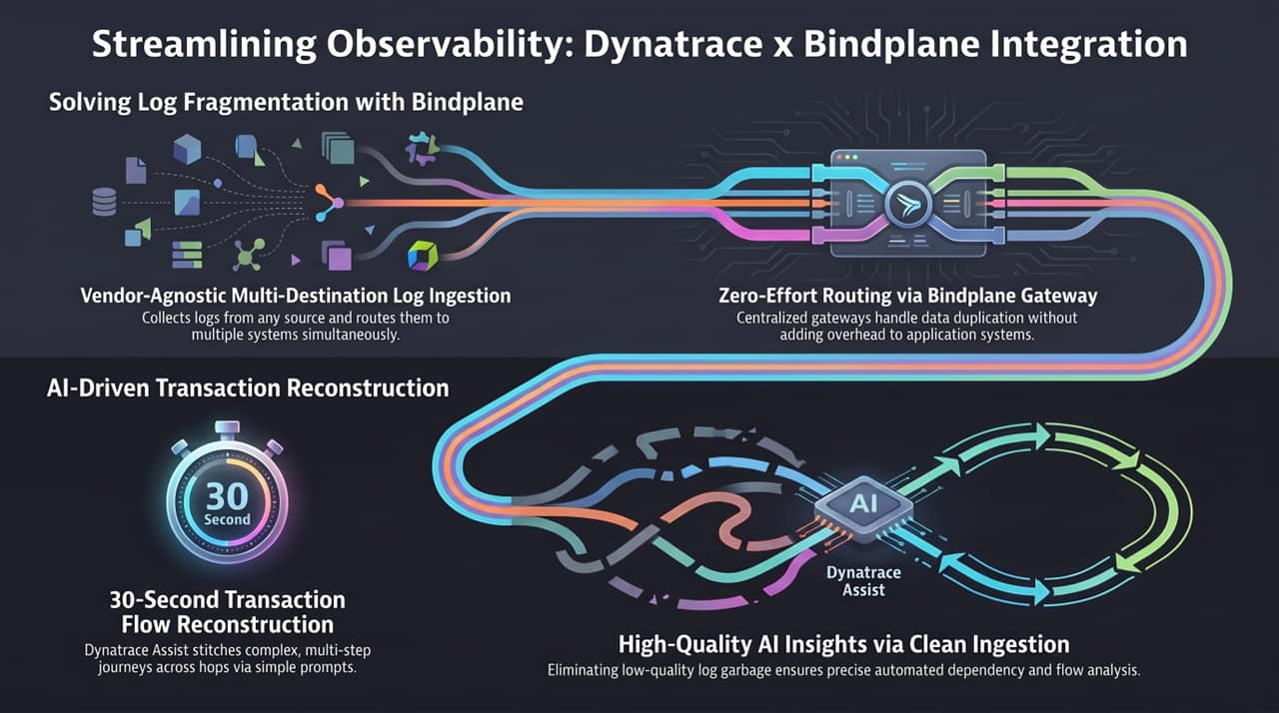
Notes:
To wrap up our deck, this executive summary slide highlights the core capabilities of the integrated Dynatrace x Bindplane architecture:
Vendor-Agnostic Multi-Destination Ingestion: Ingest logs once from any source, duplicate at the gateway without client host overhead, and route concurrently to Dynatrace, S3, or SIEM tools.
30-Second Transaction Flow Reconstruction: Replace tedious manual correlation with rapid natural language prompts powered by Dynatrace Assist.
High-Quality AI Insights via Clean Ingestion: Ensure high AI accuracy by removing noisy log data prior to storage.
By unifying ingestion pipelines and leveraging deterministic AI analysis, organizations can scale their telemetry infrastructure efficiently while supporting an AI-first operational model.
Dynatrace x Bindplane - One Source Many Destinations with AI Analysis
https://www.youtube.com/watch?v=QSUPYC_ydas

